Slide 1
MALIGNANT COMMENTS CLASSIFIER PROJECT
Prepared By:
Pratiksha Potghan

Slide 2
Agenda
Introduction
Problem Statement
Conceptual Background of the Domain Problem
Motivation for the Problem
Hardware and Software Requirements and Tools UsedAbout The DataSet
Data Analysis and Model Building Flowchart
Data Sources and their formats
All Data Preprocessing step details
BarPlot of total number of messages in each column
Correlation using the heatmap
Model building
Model performance
Parameter tuning
Interpretation of the Results
Future work
Conclussion

Slide 3
Introduction
In this project, we have been provided with two datasets namely train and test CSV files. We will build a machine learning model by using NLP using a training dataset. And using this model we will make predictions for our test dataset.
We will need to build multiple classification machines and learning models. Before model building, we will need to perform all data pre-processing steps involving NLP. After trying different classification models with different hyperparameters than will select the best model out of them. We will need to follow the complete life cycle of data science that includes steps like –
1. Data Cleaning
2. Exploratory Data Analysis
3. Data Pre-processing
4. Model Building
5. Model Evaluation
6. Selecting the best model
Finally, we compared the results of proposed and baseline features with other machine learning algorithms. The findings of the comparison indicate the significance of the proposed features in cyberbullying detection.

Slide 4
Problem Statement
The proliferation of social media enables people to express their opinions widely online. However, at the same time, this has resulted in the emergence of conflict and hate, making online environments uninviting for users. Although researchers have found that hate is a problem across multiple platforms, there is a lack of models for online hate detection.
Online hate, described as abusive language, aggression, cyberbullying, hatefulness, and many others has been identified as a major threat on online social media platforms. Social media platforms are the most prominent grounds for such toxic behavior.
There has been a remarkable increase in the cases of cyberbullying and trolls on various social media platforms. Many celebrities and influences are facing backlash from people and have to come across hateful and offensive comments. This can take a toll on anyone and affect them mentally leading to depression, mental illness, self-hatred, and suicidal thoughts.
Internet comments are bastions of hatred and vitriol. While online anonymity has provided a new outlet for aggression and hate speech, machine learning can be used to fight it. The problem we sought to solve was the tagging of internet comments that are aggressive towards other users. This means that insults to third parties such as celebrities will be tagged as unoffensive, but “u are an idiot” is offensive.
Our goal is to build a prototype of online hate and abuse comment classifier which can be used to classify hate and offensive comments so that they can be controlled and restricted from spreading hatred and cyberbullying.

Slide 5
Conceptual Background of the Domain Problem
Internet comments are bastions of hatred and vitriol. While online anonymity has provided a new outlet for aggression and hate speech, machine learning can be used to fight it. The problem we sought to solve was the tagging of internet comments that are aggressive towards other users. This means that insults to third parties such as celebrities will be tagged as un-offensive, but “u are an idiot” is clearly offensive.

Slide 6
Motivation for the Problem
The project was the first provided to me by FlipRobo as a part of the internship program. The exposure to real-world data and the opportunity to deploy my skillset in solving a real-time problem has been the primary objective. However, the motivation for taking this project was that it is relatively a new field of research. Here we have many options but less concrete solutions. The main motivation is to build a prototype of online hate and abuse comment classifier which can be used to classify hate and offensive comments so that they can be controlled and restricted from spreading hatred and cyberbullying.

Slide 7
Hardware and Software Requirements and Tools Used
Hardware:-Laptop
Software:- Anaconda, Jupyter Notebook

Slide 8
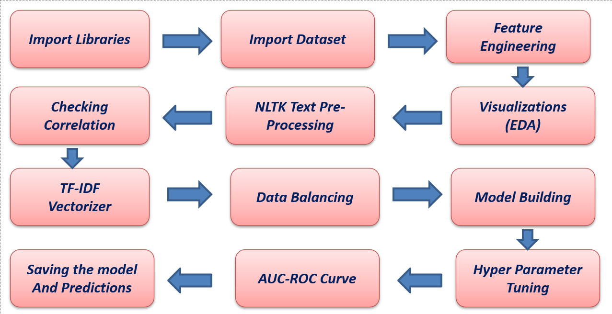
Data Analysis and Model Building Flowchart
In EDA, I checked for count of dataset using train.shape, after that checked all 37 columns of dataset.
By using df.shape we got to know that there are 2 columns in the test dataset.

Slide 9
Data Sources and their formats
The data was provided by FlipRobo in CSV format. After loading the training dataset into Jupyter Notebook using Pandas and it can be seen that there are eight columns named:
“ id, comment_text, “malignant, highly_malignant, rude, threat, abuse, loathe”.
There are 8 columns in the dataset provided:
The description of each of the column is given below:
- Malignant: It is the Label column, which includes values 0 and 1, denoting if the comment is malignant or not.
- Highly Malignant: It denotes comments that are highly malignant and hurtful.
- Rude: It denotes comments that are very rude and offensive.
- Threat: It contains an indication of the comments that are giving any threat to someone.
- Abuse: It is for comments that are abusive in nature.
- Loathe: It describes hateful comments and loathing in nature.
- ID: It includes unique Ids associated with each comment text given.
- Comment text: This column contains the comments extracted from various social media platforms

Slide 10
Data Preprocessing
For the purpose of the project the dataset has been preprocessed as follows:
Importing necessary libraries and importing dataset as a data frame.
Checked some statistical information like shape, number of unique values present, info, finding more values etc.
Checked for null values and did not find any null values and removed Id.
Done feature engineering and created new columns viz label which contain both good and bad comments which is the sum of all the labels, comment length which contains the length of comment text.
Visualized each feature using seaborn and matplotlib libraries by plotting categorical plots like pie plot , count plot, distribution plot and wordcloud for each label.
All these steps were done on both train and test datasets. Checked correlation using heatmap. After getting a cleaned data used TF-IDF vectorizer.

Slide 11
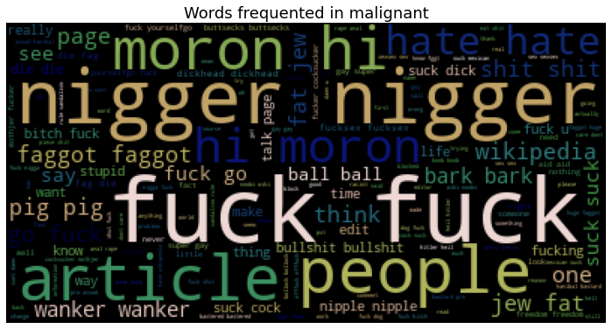
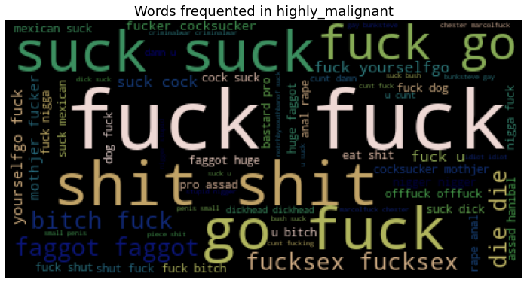
Words Frequent in malignant and high malignant

Slide 12
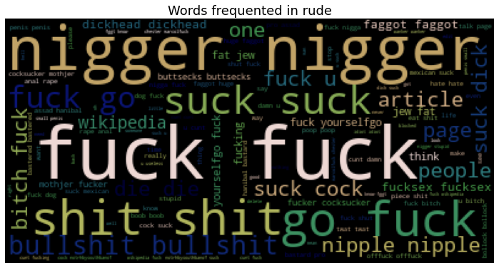
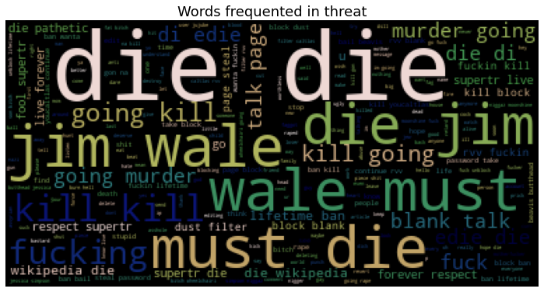
Words Frequent in rude and high threat

Slide 13
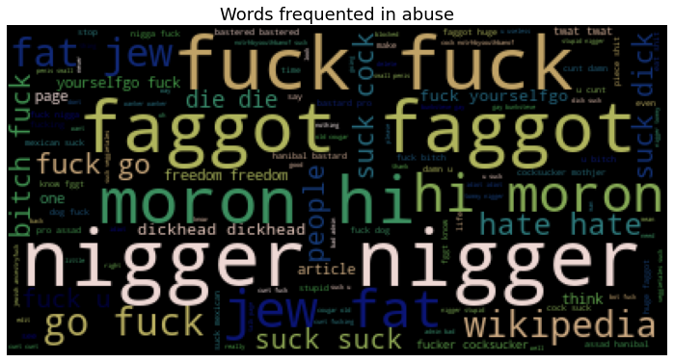
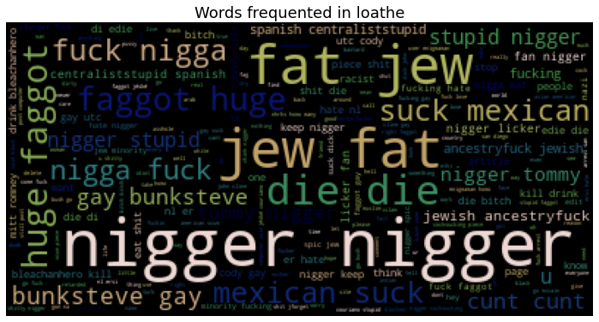
Words Frequent in abuse and high loathe

Slide 14
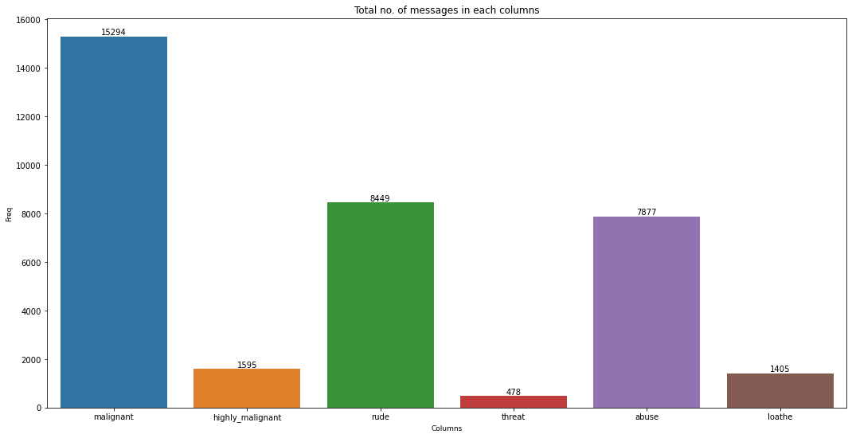
BarPlot of total no of messages in each column

Slide 15
Model Building
In this project there were 6 features which defines the type of comment like malignant, hate, abuse, threat, loathe but we created another feature named as “label” which is combined of all the above features and contains the labelled data into the format of 0 and 1 where 0 represent “NO” and 1 represents “Yes” . In this NLP based project we need to predict the multiple labels which are binary. I have converted text into feature vectors using TF-IDF vectorizer and separated our feature and labels. Also, before building the model, I made sure that the input data is cleaned and scaled before it was fed into the machine learning models.
After the pre-processing and data cleaning I used remaining independent features for model building and prediction. The classification algorithms used on training the data are as follows.
1. Logistic Regression
2. MultinomialNB
3. LineraSVC
4. Gradient Boosting Classifier
5. Decision Tree Classifier
6. Ada Boost Classifier

Slide 16
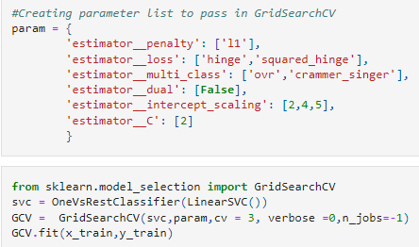
Hyper parameter Tuning
I have used 6 LinearSVC classifier parameters to be saved under the variable "parameters" that will be used in GridSearchCV for finding the best output. Assigned a variable to the GridSearchCV function after entering all the necessary inputs. And we used our training data set to make the GridSearchCV aware of all the hyper parameters that needs to be applied on our best model

Slide 17
Interpretation of the Results
LinearSVM and Random Forest models perform best in this project
At first we get only 91.76% accuracy from LinearSVM But after parameter tuning we get 91.77% accuracy.There is no defference in accuracy score after parameter tuning.
Using hyper parameter tunning we can improve our model accuracy, But here in this model the accuracy did not increased.
It is always advised to all of us that atleast we need to use 5 Algorithm in order to figure out which one is performing best among them and we choose that one and we send that for hyper parameter tuning to know that best parameter.

Slide 18
Future Work
For future improvements, the following step we thought to take-
Replacing model with a latest/different model
Using other robust datasets
Predicting results on different attributes
It would seem that better performance might be achieved if multiple learners were combined.

Slide 19
Conclusion
When I was working on this project, many complications were involved. There are many variables/attributes to consider in determining our target value, we need a lot of calculating power to get a near 100% accuracy result. And it is very difficult to accurately predict any comment good or bad.
For any machine learning project my suggestion is first you have to understand the problem at ground level.if you don’t allow yourself to work with diligence.if you don’t work harder anything that you are doing or will do, not only in the case of machine learning but also in the life cycle would be futile. Maybe, my endeavor assist you whenever you will get stuck.

Slide 20
Thank you

